Slide 1


Database Corruption
Red Gate Software

Slide 2
Goals
Understand what database corruption is and where it comes from
Learn multiple methods for detecting database corruption
Understand your options for resolving corrupt databases

Slide 3


Before we start
Notes:
These things are note equal. Don’t expect that level of knowledge.

Slide 4
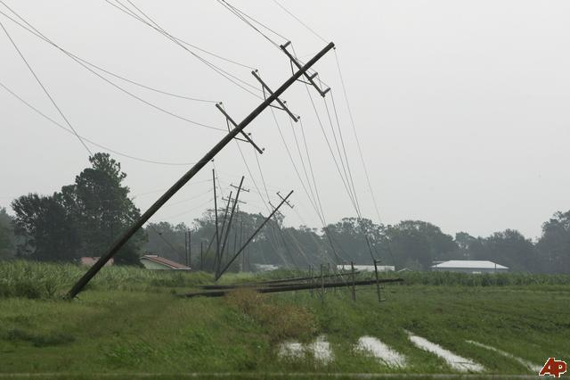
Why DBAs Are Paranoid
User error
Coding problems
Hardware issues
Software issues
Power Loss

Slide 5

… And if that wasn’t enough
Fires
Floods
Terrorism
Meteor strikes
Sunspots
Extra-solar radiation
Notes:
All of which can cause corruption on disks
Picture: Heat signature of extra-solar radiation

Slide 6
What is Database Corruption?
All storage is on disks
All disks go through I/O subsystem within Windows
SQL Server manages storage within files
Data consists of double linked list of pages
Corruption is an inconsistency in storage
Notes:
And it can occur at multiple levels. Think about everything stored on the disk, any or all of it can go south from system tables to indexes to materialized views (which are just indexes), etc.

Slide 7
How to Detect Corruption
Error messages
Database Consistency Checks (but not DBCC)
CHECKDB
CHECKALLOC
CHECKTABLE
CHECKFILEGROUP
CHECKCATALOG
CHECKIDENT
CHECKCONSTRAINTS
Notes:
DBCC is Database Console Commands. Just a nit worth mentioning. CHECK DB is the big one, covers all but CHECKIDENT & CHECKCONSTRAINTS + a bunch more CHECKALLOC – system catalogs & allocation checks
CHECKTABLE – system catalogs & table checks & cross-table checks on indexed views
CHECKFILEGROUP – system catalogs & filegroups & per-table & spatial xml for that filegroup
CHECKCATALOG – system catalogs & cross-catalog checks
CHECKIDENT – validates identity for the given table
CHECKCONSTRAINTS – foreign keys & check constraints

Slide 8
CHECKDB
Create a static view of the database
System catalog consistency check
Database allocation consistency checks
Table consistency checks
Cross-table checks
Notes:
Static view, but consistent with transactions so that no open trans are checked. No blocking locks are held. Basically creates a snapshot that’s hidden
Catalog checks are done because DBCC needs them to run the rest of the checks. Sysallocunits, sysrowsets,sysrscols
Check of the page tracking structures within the database, not the pages themselves. It’s fast
Each table. Every page. Every record on the page. Column checks inside the record. Cross-page checks on indexes & b-trees, LOB & filestream
Service broker data, indexed views, xml indexes, spatial indexes
Picture

Slide 9
CHECKDB Output
Service Broker checks
Allocation errors
Errors that can’t be related to a table
Table data
Summary of allocation & consistency errors
Minimum repair level to fix errors
Additional output
Notes:
Table data includes number of rows and pages in the table and a listing of errors
Additional output: sql server error log, application even log, output to sys.dm_exec_requests (demo)

Slide 10
When & Where to Run CHECKDB
As often as practicable
Before/After backups, but don’t assume backup is good
On large databases, use PHYSICAL_ONLY
On large databases, you still need to do the logical checks too
Run CHECKCONSTRAINTS after a repair
Notes:
Frequency: Personally, I’d tie it to the FULL backup. However often you do that, you should also do a CHECKDB
Breaking down the logical and physical can be done with a backup & restore since the restore will have logical consistency errors intact. Also can be done with Availability Groups since they copy at the page level.

Slide 11
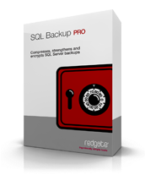
Demo
Show how to run CHECKDB
Explain the pieces of the output
Show how to modify the output
Demonstrate integrating DBCC check with backups

Slide 12
CHECKDB Errors
Service Broker example: Msg 8966, Level 16, State 2, Line 1: Unable to read and latch page (1:524561) with latch type SH. 23(Data error(cyclic redudancy check).) failed.
Another: Msg 8906, Level 16, State 1, Line 1 PAGE (1:158181) in database ID 7 is allocated to the SGAM(1:3) and PFS(1:8088) but was not allocated to any IAM.
Notes:
8966: IO error, shock
8906:

Slide 13
CHECKDB Errors
Non-clustered index: Object ID 423211, index ID 2, partition ID 342234, alloc unit 43242343 (type in-row data) page ID (2:2423) contains an incorrect page ID in its page header. The PageId in the page header = (2.4323).

Slide 14
CHECKDB Errors
Unknown object errors: Msg 8939, Level 16, State 98, Line 1 Table error: Object ID 0, index ID -1, partition ID 0, alloc_unit ID 234233 (type Unknown) page (1:797)

Slide 15
CHECKDB Errors
Consistency error: Msg 2508, Level 16, State 3, Server MyServer, Line 1 The in-row data RSVD page count for object ‘MyObject’, index ID 0, partition ID 22249, alloc unit ID 979797(type in-row data) is incorrect. Run DBCC UPDATEUSAGE.

Slide 16
Demo
Run DBCC against a database with corruption to see error output
Run DBCC with only error output

Slide 17
Fixing Errors
A non-clustered index: drop and recreate
Row counts: UPDATEUSAGE
Everything else: restore from backup
If you can’t restore, why not?
If you really can’t restore, repair
REPAIR_ALLOW_DATA_LOSS
REPAIR_REBUILD

Slide 18
Repair
All repair options can lead to data loss
Data loss can be:
Rows
Table
Tables
Database
Because it’s based on recovery of a page
Up to 8k worth of information
Only use as a last resort when you can’t restore from backup
Why can’t you restore from backup?
Notes:
REPAIR_REBUILD
REPAIR_ALLOW_DATA_LOSS

Slide 19
Demo
Run a repair in order to see what’s affected

Slide 20
Homework
CHECKSUM
DBCC last run date
Alerts
Tested restores

Slide 21
Goals
Understand what database corruption is and where it comes from
Learn multiple methods for detecting database corruption
Understand your options for resolving corrupt databases

Slide 22
Resources
Help, my database is corrupt. Now what?
Finding Data Corruption
Database Corruption
What Is Corruption
Beating Backup Corruption
Microsoft SQL Server 2008 Internals by Kalen Delaney, Paul Randal, et al.

Slide 23

The End
Questions?
www.sqlservercentral.com/forums
Sponsored by Red Gate Software and the SQL DBA Bundle
Speak to the Red Gate team during the breaks for more info about the tools in the SQL DBA Bundle
Backup and recovery
Troubleshooting
Productivity
Performance monitoring
Change management
Storage and capacity planning
Documentation

